Slide 1

Flight Price Prediction Project
CHAGANTI SAI MAHATHI

Slide 2
Abstract:
Most of the people are not aware of buying a flight ticket at the right time, they pay more for the ticket than usual. The price of the ticket may vary based on different factors. The factors might be based on seasons like winter, summer, festival, ..etc. Prices of the ticket may also fluctuate during day and nights and also based on number of tickets available.By considering certain features like depature time , arrival time and the number of days remaining for the depature and based on time it gives the best time to purchase a Ticket.By using the information of factors that influence change in airline fare prices and how the factors are related to change in the fare price of the ticket.By using the information above to built a system to predict the fare price of the ticket priorly using the machine learning techniques like linear regression, Random forest regressor, Decision tree regressor and also using KNN regressor and SVR models, that might be helpful for the passengers to buy a ticket or not.

Slide 3
Objectives:
Aim of the Project:
The aim of the project is to predict the dynamic fare price of the ticket using the machine learning regression techniques on collected data.
Scope of the Project:
The scope of the project is to estimate minimum airfare over specific period of time
Project Domain:
Data analysis is a process of extracting the useful information from the given set of information by analysing the data through various ML algorithms and techniques.

Slide 4
Introduction:
There are some frequent passengers for the airlines, these people can be able to know when the airfare prices will be low and when it goes to high. But there are many people who doesn’t know the fluctuations. Airline increase the price of the ticket for their Revenue management. The goal of the career will be to bult it’s income, while the person who wants to purchase a ticket will look for the low cost. One of the report says that India is the third biggest avionics showcase of world in 2020. Here we collect the data from different websites and apply machine learning models. We use different Regression methods to predict fare price at a given time.

Slide 5
Design and methodologies:
Data Collection and Processing of the data:
The Data is collected from different online ticketing websites using web scraping techniques and all the data collected from different platforms are created as a Data frame which can be further analysed.

Slide 6
Steps to Process EDA:
1
Import all the necessary Libraries.
Load the dataset.
2
Checking the null values and null count of each column in the given dataset- No Null count.
Data Visualization using bar graph.
3
Encoding the data.
Checking Outliers and Skewness.
getting the data dimension - (1659, 9)
Data type of each column of the data frame is given below.
Getting the value counts of each column of the data frame.
Describing the dataset.
Checking the correlation.
Feature Selection Process.
Creating a Desired model.

Slide 7
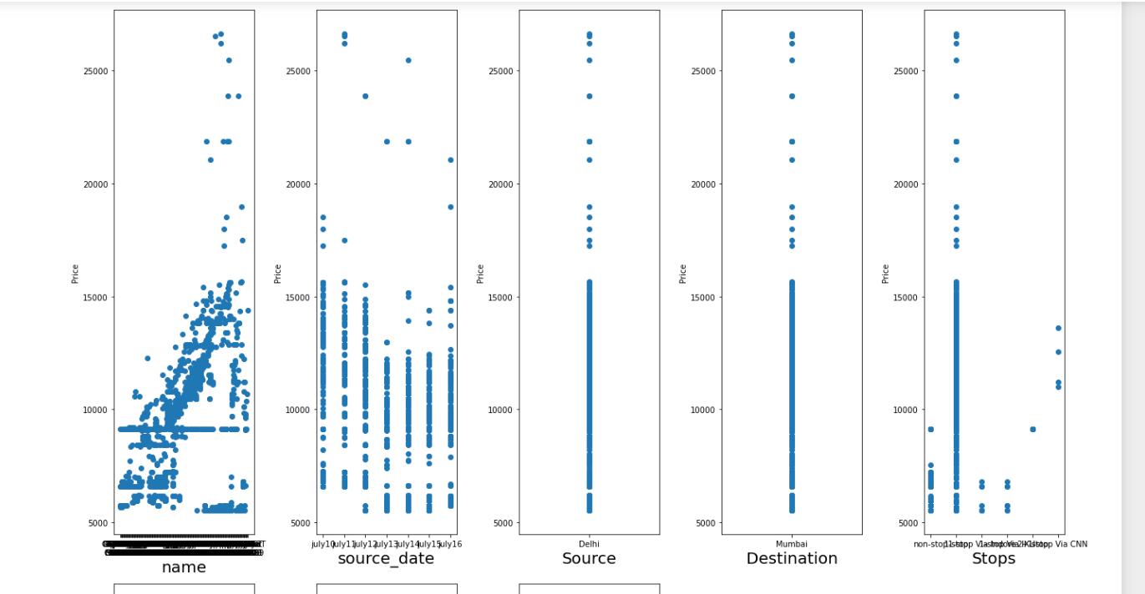
Checking the null value count DataVisualization using bar graph:
After looking in to the data we got the ticket price label with some null values which are removed by replace the comma with space and changing them to float.
Data visualisation using scatter plot is shownof all the features with respect to label Price.

Slide 8
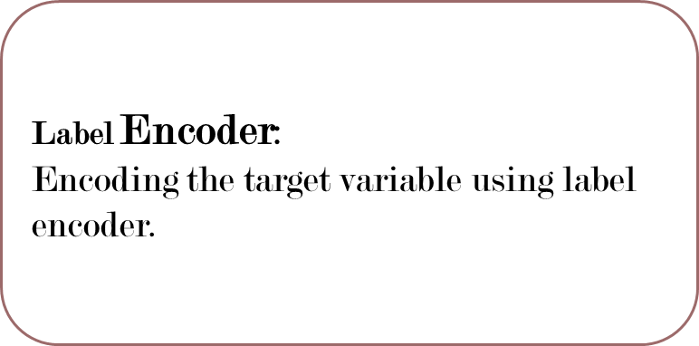
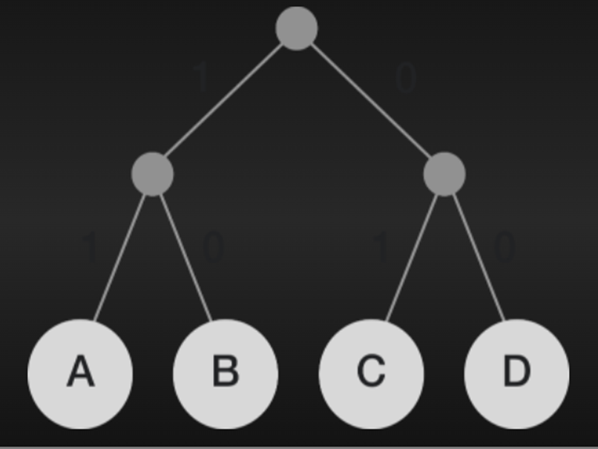
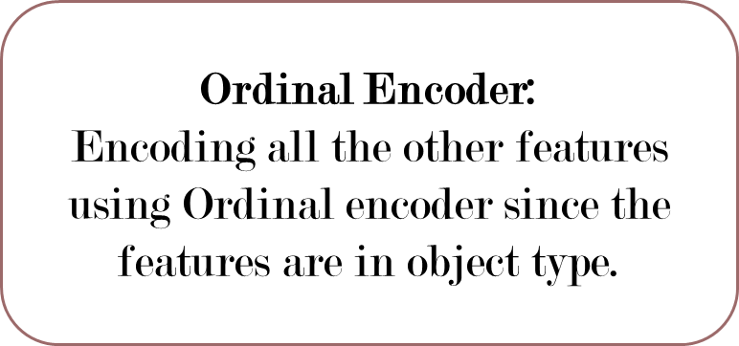
Encoding the Data

Slide 9

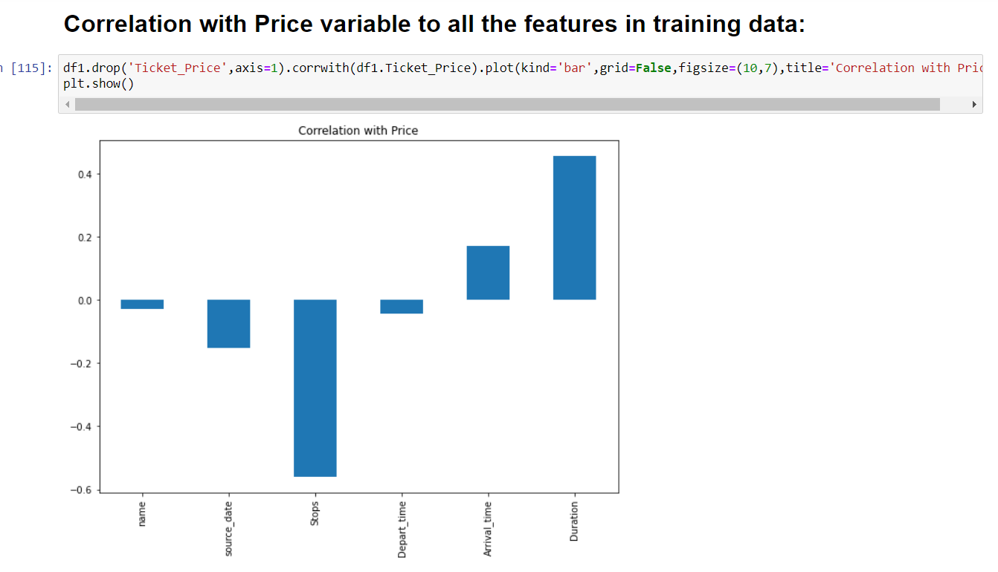


Slide 10
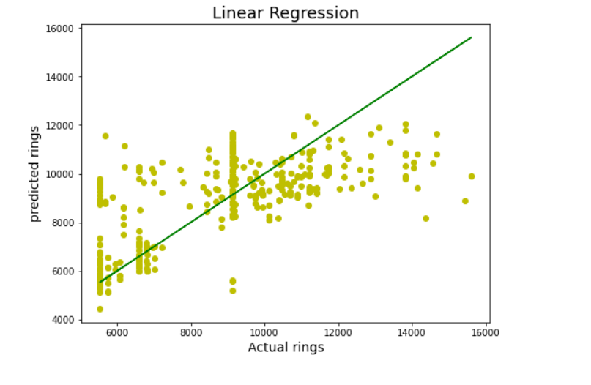
Model Building:
Once after removing all the outliers using Z-score technique the model is ready to be build.
Linear regression model:
linear regression model to test the data the r2 score of the predicted data is given as 0.49.
Once the model is linearly regressed then use lasso regularization technique to get the maximum best output-0.4991.
Using the best cross validation score we get the output for this model as
0.4159

Slide 11



Hyper Parameter tuning using Ensemble approaches:
RandomForestRegression:
DecisionTreeRegression:
KNeighborsRegression:
SVR model:
Out of which KNN model considerably best model and this model is saved for the future prediction.

Slide 12
Conclusion:
The data which is collected and modelled can only predict 60 percent accurately.so there need to be more data or more techniques to be placed for getting best accuracy.
Most of our online ticketing platforms uses these ml techniques which can be further processed and modified for both the people and airline company satisfaction.

Slide 13


